Slide 1
Q.Peptide
Qiskit Fall Fest 2026 / submission
Quantum-assisted constrained optimization
for antimicrobial peptide design
189 tests · Qiskit 2.5.2 · QAOA on ibm_fez, job db16cahb694s73drs9vg
Notes:
Open by naming the question, not the technology. The one thing to land: every number in this deck came out of a run that actually happened, including the numbers that make the project look bad.

Slide 2
The structure that makes a peptide
kill bacteria is the same structure
that makes it lyse your red blood cells.
Improving either property alone is easy. The trade-off is the problem worth solving, and it is what a medicinal chemist actually asks about: which two or three substitutions should I make?
02
Notes:
Resist filling this slide. The single-objective 'maximise activity' formulation is known to fail in the literature: it reproduces over-cationic hemolytic analogues. That is why hemolysis has to be penalised explicitly in the objective.

Slide 3
THE PROBLEM, STATED
maximise ΔS(x) = Σ_i Δ_i x_i + Σ_i<j Δ_ij x_i x_j
subject to Σ_i x_i ≤ K x_i + x_j ≤ 1 x_i ∈ {0,1}
x_k = 1 means apply substitution k. An explicit (position, from, to) triple, not an opaque latent bit.
Δ_i and Δ_ij are first- and second-order finite differences of the score S, taken on real mutant sequences.
A mutation budget K plus pairwise exclusivity from the conflict graph. Combinatorial, not box constraints.
The quantum computer is not simulating protein folding. It solves that subset-selection problem.
03
Notes:
Say the folding disclaimer out loud, because the audience will assume otherwise. S combines predicted activity and predicted hemolysis. The sign convention is fixed in exactly one place in the code and a test asserts the exact solver's optimum is the maximum-S candidate.

Slide 4
The coefficients
are computed,
not fitted.
WHAT IS NEW
dimension | Tučs et al. 2023 | Q.Peptide
binary variables | 64 opaque VAE latent bits | explicit substitutions
QUBO coefficients | fitted to sampled scores | computed exactly
surrogate fidelity | not quantified | measured
optimality baseline | none, annealer only | brute-force exact optimum
hardware paradigm | analog annealing | gate-based QAOA
Each one comes from running the ML models on the corresponding mutant. 92 to 106 model calls at N=14. That removes a whole layer of surrogate error and makes the error that remains measurable.
04
Notes:
This answers 'what is new here'. Credit the prior work openly: quantum optimization of nonhemolytic AMPs was done and wet-lab validated in 2023. What differs is how the QUBO is built, that its error was measured, and that it is benchmarked against the exact optimum.

Slide 5
One path, shared by the API and the experiment scripts
HOW IT RUNS
01
Generate candidates
Structural and physicochemical filters, then an ML pre-screen. Output: 14 binary variables and a conflict graph.
02
Compute the landscape
Δ_i and Δ_ij by real model evaluation on each mutant. Nothing is fitted to samples.
03
Build and verify
Penalties derived from the exact objective span, then checked by enumeration over every assignment.
04
Solve
QAOA at p = 1, 2, 3 against exact enumeration, simulated annealing, greedy, local search, uniform random.
05
Re-score and rank
The real models run again on every candidate. Ranking never uses QUBO energy.
05
Notes:
Step 5 is the one to stress. Because the surrogate degrades at three mutations, candidates are ranked by direct ML re-scoring rather than QUBO energy. That decision came out of a measurement, which is three slides from here.

Slide 6
QUBO → Ising → QAOA
THE QUANTUM PART
E(x) = xᵀ Q x + c Q symmetric, Q_ij = c_ij / 2
QUBO
The factor of two is where naive implementations go wrong. A test asserts matrix and polynomial agree on every assignment.
x_i = (1 − Z_i) / 2 → diagonal SparsePauliOp, I / Z / ZZ only
ISING
The identity offset is kept, so ⟨x|H_C|x⟩ equals E_QUBO(x) exactly. Verified on every basis state.
|ψ(γ,β)> = Π_l e^(−iβ_l ΣX_i) e^(−iγ_l H_C) |+>^N
QAOA
H_C is diagonal, so e^(−iγH_C) factorises exactly into commuting RZ and RZZ rotations.
Building that circuit explicitly, instead of exponentiating a sparse matrix once per objective call, took a run from minutes to under two seconds. The fast NumPy path is asserted to match real Qiskit to 4.6e−16.
06
Notes:
If asked about the mixer: standard transverse-field X mixer with penalty-based constraints. An XY mixer preserving Hamming weight would remove the penalties entirely. It is the documented next step and the single most promising improvement.

Slide 7
Structural claims are checked by a test,
not asserted in a README
VERIFICATION
Matrix ≡ polynomial
Penalty sufficiency
the derived Q reproduces the source polynomial on every assignment
every infeasible assignment sits strictly above every feasible one, by enumeration
A tiny penalty must fail
Slack encoding
a test asserts the verifier rejects a deliberately insufficient penalty
the representable set is exactly {0...K}, with no over-coverage
Ising ≡ QUBO
Simulator ≡ Qiskit
checked on every basis state, identity offset included
the fast path matches a real Qiskit circuit to 4.6e−16
A hard-coded penalty of 1000 is rejected. The penalty comes from the exact span of the unconstrained objective, then gets verified by enumeration.
07
Notes:
The 'tiny penalty must fail' test is the one worth calling out. A verifier that always returns true is worthless, so the suite proves the verifier is capable of failing. Two claims in my own documentation turned out to be false during this build and were corrected.

Slide 8
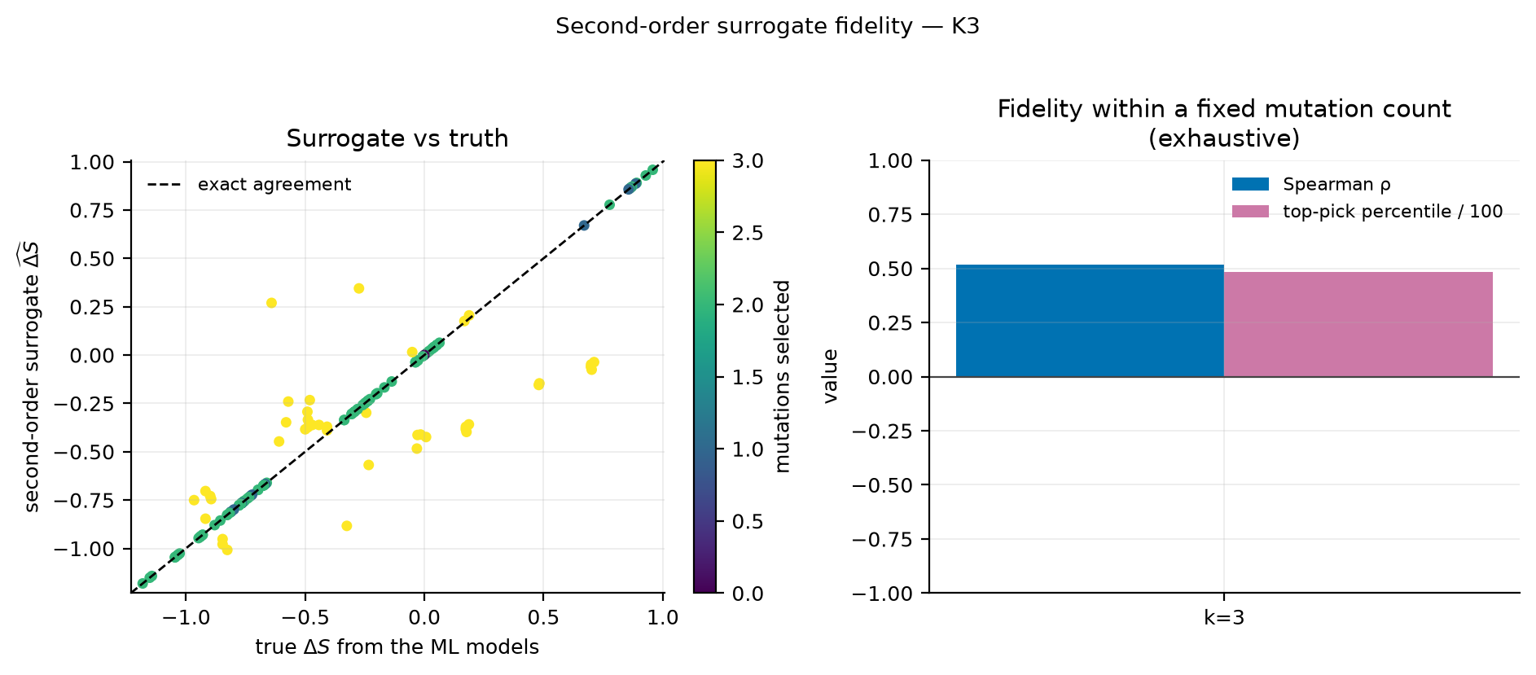
We measured where
the QUBO stops
being exact
RESULT 1, THE UNFLATTERING ONE
K ≤ 2 — exact
All 102 feasible candidates: MAE 0.0000, Spearman 1.000.
K = 3 — mediocre
All 316 feasible 3-subsets: ρ = 0.516, but the surrogate’s own top pick ranks 164th of 316. The 48th percentile.
fig. 1 — surrogate fidelity, K = 3
So the pipeline ranks by direct ML re-scoring, never by QUBO energy.
Notes:
Lead with this rather than hiding it. A judge who finds the weakness themselves discounts everything else you said. Measuring the validity regime is what let us make a correct design decision downstream.

Slide 9
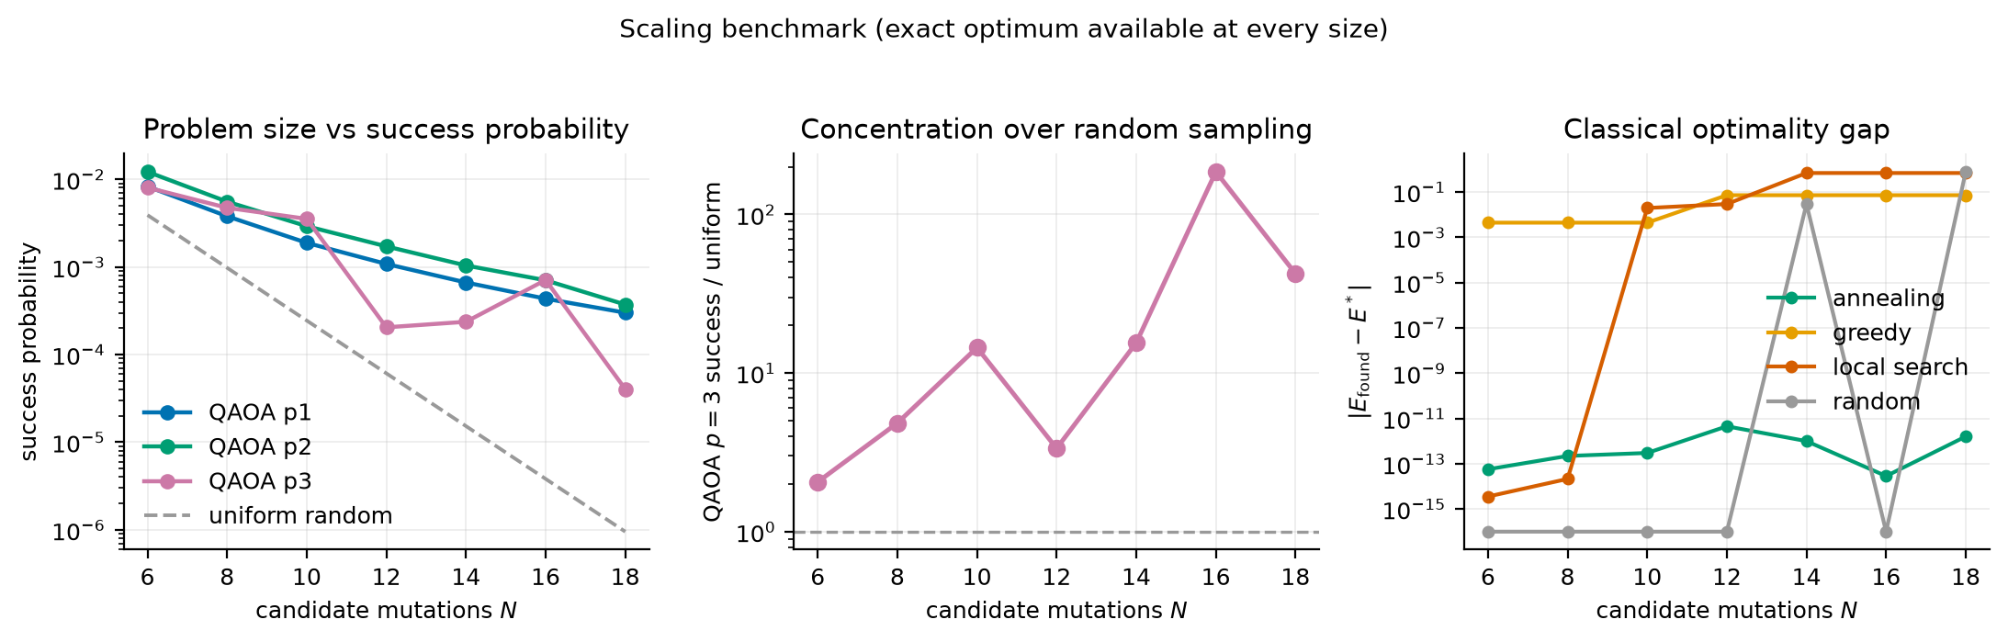
fig. 2 — success probability as a multiple of uniform random, N = 6 to 18
390×
Depth does not reliably help. p=3 is worse than p=2 at N=12, 14 and 18. One run reached 0.9× uniform, which is worse than random sampling.
uniform random at N=18, p=2. Uniform random is the baseline that matched QAOA in the closest comparable study.
Simulated annealing reaches the exact optimum at every size tested. QAOA never beats it. No advantage is claimed anywhere in this project.
Notes:
The 0.9x result reproduces Boulebnane et al. directly. They found QAOA on a peptide problem could be matched by random sampling. We did not bury that, we reproduced it and put it next to our own best number.

Slide 10
Noise, and what is
done about it
RESULT 3
Readout mitigation
Per-qubit confusion-matrix inversion. A full 2ⁿ×2ⁿ matrix is impossible at 16 to 20 qubits, so the standard tensored model is used. That independence assumption is stated, not hidden.
noise model | success | feasible
noiseless | 0.00525 | 0.544
low, 1e−3 | 0.00281 | 0.442
representative, 1e−2 | 0.00085 | 0.192
high, 3e−2 | 0.00049 | 0.036
Decoupling and twirling
XY4 sequences plus gate and measurement twirling through Qiskit Runtime options.
Validated both ways
Recovers an injected 4% readout error to within 1.2%. On a noiseless backend it finds p01 = p10 = 0.000000, so it applies no spurious correction to clean data.
At representative hardware error rates success falls 6×, and feasible probability goes from 54% to 19%.
10
Notes:
The measured gain is modest and at high noise slightly negative. That is expected, not a failure. Readout mitigation corrects measurement error only, while the dominant loss at these gate counts is accumulated gate error that no post-processing can undo.

Slide 11
RESULT 4 / REAL QUANTUM HARDWARE
94%
of ideal-simulation success probability, on a real device. It also sampled the exact optimum.
ibm_fez · IBM Heron r2, 156 qubits
job db16cahb694s73drs9vg · 8 qubits · 4096 shots
success 0.00781 · 2.0× uniform · E* found
Parameters were optimised on the simulator. Hardware sampled the final circuit only, in one job. At 87 two-qubit gates the circuit is short enough that real structure survives, which is exactly why the run was sized small instead of using the headline config.
Notes:
This is the slide a Qiskit Fall Fest audience cares about most. Be precise: we did not optimise parameters on hardware, we sampled the final circuit. Sizing it small was deliberate, to get an interpretable result rather than a noise-dominated one.

Slide 12

Routing overhead, and mitigation on the metal
WHAT THE DEVICE COST US
A 55% increase, all of it routing. This is the concrete reason the project reports logical and transpiled metrics separately instead of quoting logical depth alone.
28
56
87
logical 2q gates
abstract all-to-all
on ibm_fez connectivity
on device | raw | mitigated
success | 0.00781 | 0.00735
feasible | 0.2847 | 0.3213
Measured readout error: p01 = 3.11%, p10 = 3.32%, worst qubit 18.6%. Inversion improved feasible probability by 12.9% while slightly reducing success. Sharpening the broad distribution adds variance to individual low-probability outcomes, and the optimum is exactly such an outcome.
12
Notes:
Mention the bug only a real device could catch: readout calibration used backend.run(), which IBM Runtime removed. It failed on hardware and nowhere else. Fixed with a SamplerV2 fallback that disables measurement twirling during calibration.

Slide 13
Stratifying by publication inverts the result
RESULT 5 / THE DEEPEST LIMITATION
49.8%
59.4%
A pair whose members come from different papers carries inter-laboratory and inter-organism variation that no sequence model could predict. That stratum is strongly anti-correlated, ρ = −0.44, and it drags the pooled figure down.
pooled across all held-out point-mutant pairs. A coin flip.
restricted to pairs assayed in the same study. 736 pairs, ρ = 0.216.
Honest reading: 59% is weak. Above chance, and the right order of magnitude for a tool that proposes candidates for experimental follow-up. Not one that replaces the experiment.
13
Notes:
The models are trained on natural peptides and asked about point mutants. DRAMP contains natural analogue series, so the held-out split already holds real point-mutant pairs with both members independently assayed. This study is the project's most important methodological catch.

Slide 14
Four things we are careful not to claim
CLAIMS THIS PROJECT DOES NOT MAKE
No quantum advantage
Instances are tiny, and simulated annealing reaches the exact optimum at every size tested.
No novelty for quantum AMP design
That was done and wet-lab validated in 2023. What differs is how the QUBO is built and measured.
No experimental efficacy
Every sequence is a model-predicted computational candidate. Nothing was synthesised or assayed.
No claim the models are strong
Hemolysis beats a mean baseline by 3.5%. Mutation-direction accuracy is about 59%.
A verified quantum optimization pipeline whose scientific limits were measured rather than assumed, including the limits that make it look bad.
14
Notes:
Ten known limitations are tabulated in the README, including two claims in my own documentation that were wrong and were corrected after an audit. Volunteering that is the entire point of this slide.

Slide 15
Every page renders a real executed run
No demo mode, no placeholder data. If nothing has been run, each page says so instead of showing an invented result.
overview · quantum · benchmark — React, FastAPI, research documents typeset in the browser
Notes:
Worth stating plainly: the 'no run loaded' empty state was a deliberate decision. A dashboard that invents plausible numbers when nothing has run is exactly how a demo misleads a judge.

Slide 16
Every figure here regenerates
from the repository
REPRODUCE IT
python -m backend.experiments.final
python -m backend.experiments.hardware_run
uvicorn backend.app:app
Regenerates every result in this deck.
The real-hardware run. Needs an IBM token.
Plus npm run dev for the interface.
The repo ships an executed notebook with embedded outputs, a design document, an adversarial self-review, and an audit recording what was claimed, what was built, and the two claims that were wrong before being corrected.
Questions welcome. The hard ones especially.
16
Notes:
Close by inviting scrutiny. The project's whole argument is that its limits were measured rather than hidden, so the hard questions are the ones it was built to answer.

